Slide 1
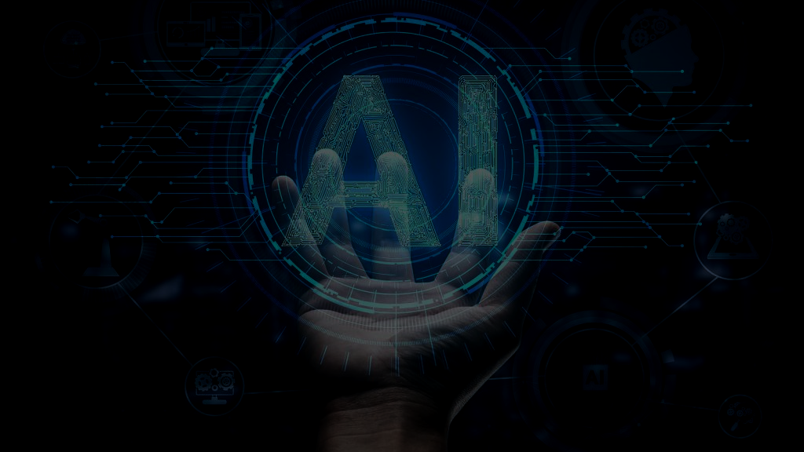

Personal AI Assistant
Government Polytechnic Pune​
Group No: 17
Shubhankar karajkhede. 1903030
Prathamesh Shimpi.1903053
Tanmay Ladhe.1903038
Pranav Madane.1903040
Department of Electronics & Telecommunication

Slide 2

Project Motivation
Project Introduction
Aims & Objectives
Literature Survey
H/W , S/W Requirements
Circuit Diagram
Block Diagram
Component Specifications
Advantages and Limitations
Conclusion
References

Slide 3

Project Motivation
Daily working schedule of every human being is getting tight day-by-day.The daily task which we perform like everyday are increasing.Besides this we all need some time for our other things.
So the basic idea of the Personal AI assistant is to do this daily tasks for us.
By a single click we can automate many of our daily tasks like sending emails,whatsapp messages,listening songs,opening websites like MIS,YouTube,google,etc.
We can also say that the we got motivation from the movies like Chappie,Iron-Man,books like life 3.0 which simply are the basically based on the fiction and fun but the concepts in them are now possible with modern technology
So,we tried to work on this project under the guidance of our expert college faculty to make a AI PERSONAL ASSISTANT.

Slide 4
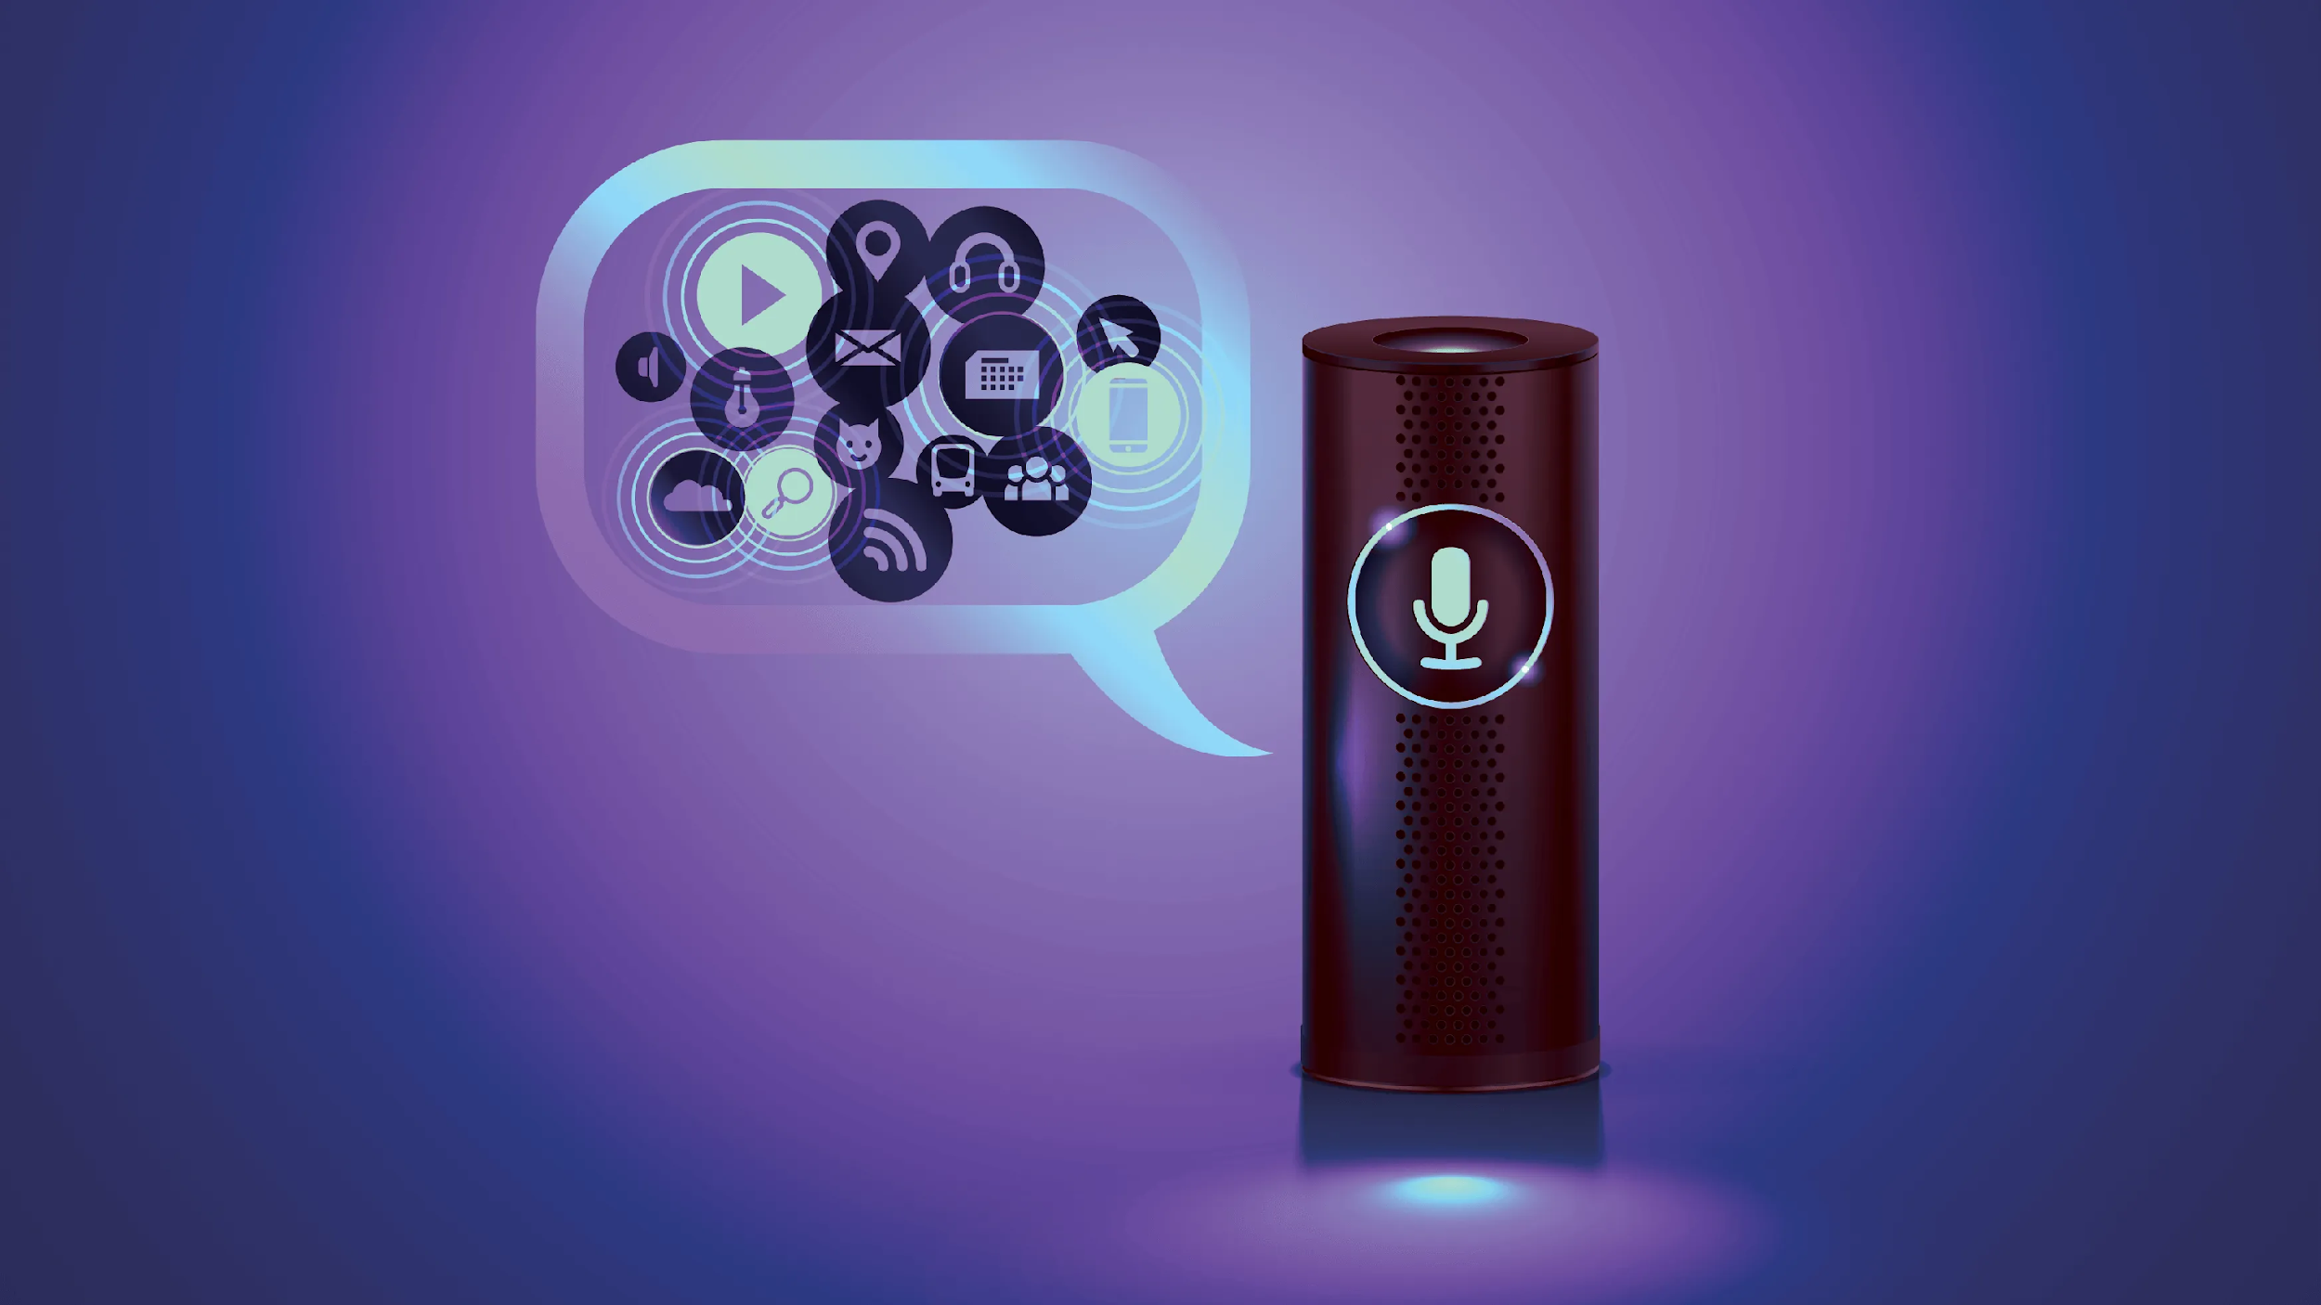
Introduction :
AI assist is program like Google or Amazon that is capable of listening, Searching and follow the command.
AI assistant or digital assistant, is an application program that understands natural language voice commands and completes tasks for the user.
A simple AI assist is one of the most common software used in any mobile or PC. We are introducing the basic concepts of AI assist.

Slide 5
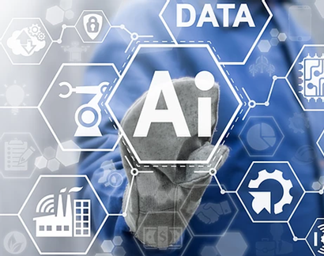
Aims & Objectives
The basic objective of AI (also called heuristic programming, machine intelligence, or the simulation of cognitive behavior) is to enable computers to perform such intellectual tasks as decision making, problem solving, perception, understanding human communication (in any language, and translate among them), and the like.
Proof of this objective is the blind test suggested by Alan Turing in the 1930s: if an observer who cannot see the actors (computer and human) cannot tell the difference between them, the objective is satisfied.

Slide 6
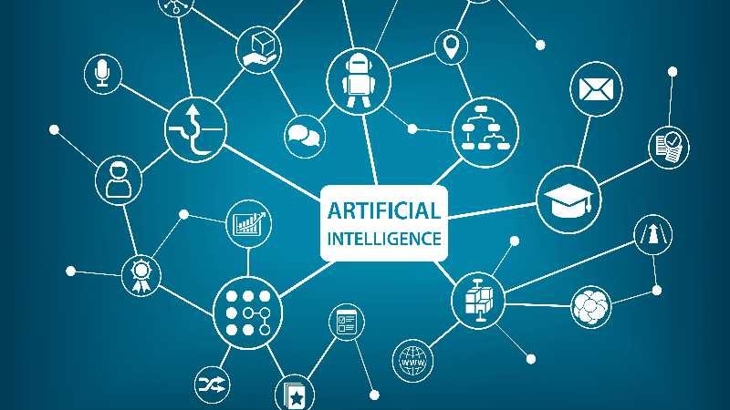
Need of AI
1. The companies today think that they want to mechanize all the regular and routine work.
2. We need Artificial Intelligence (AI) because the work that we need to do is increasing day-to-day.
3. So it's a good idea to automate the routine work. This saves the manpower of the organization and also increases the productivity.
4. So, the basic requirement of Al can start from a very small platforms to the large industries

Slide 7
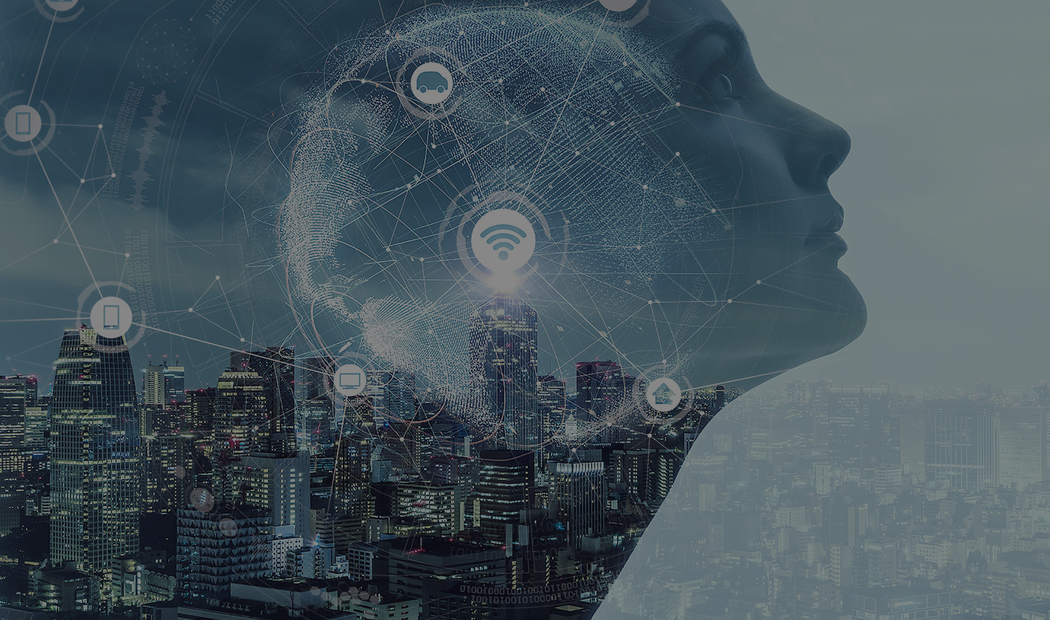
Overview
So the basic idea of this AI assistant project using the python language is to automate the day to day life task and to get the brief introduction about machine learning and artificial intelligence. In the early stages of programming and coding this particular concept of AI must be an awful thought and only few would have thought about this but in today's modern life where the technology is going beyond our imagination we can say that this project may be able to automate at least my small bedroom

Slide 8
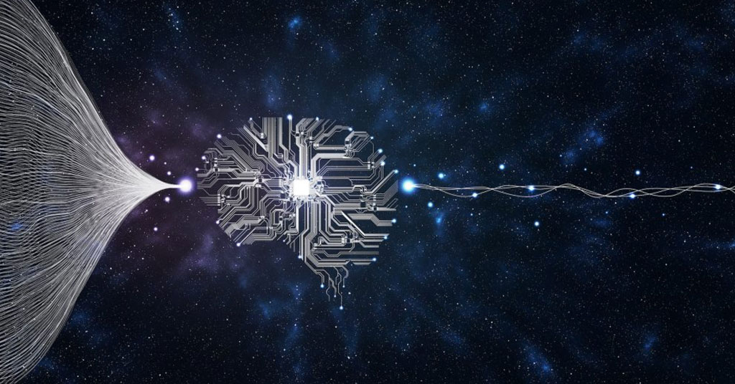
Literature
Sr. No. | Reference Name (Write Paper Title)/Publication Year | Seed Idea/ Work description | Problems found | Any other criteria
1 | Artificial intelligence that understands object relationships November 29, 2021 | A new machine-learning model could enable robots to understand interactions in the world in the way humans do. How AI can recognize the shapes and its respective colours
2 | Mind-controlled robots now one step closer | Researchers teamed up to develop a machine-learning program that can be connected to a human brain and used to command a robot. The program adjusts the robot's movements based on electrical signals from the brain. The hope is that with this invention, tetraplegic patients will be able to carry out more day-to-day activities on their own. | Complex Algorithm for thoughts control | Mind controlled wheel chair for proposed by this initiative

Slide 9
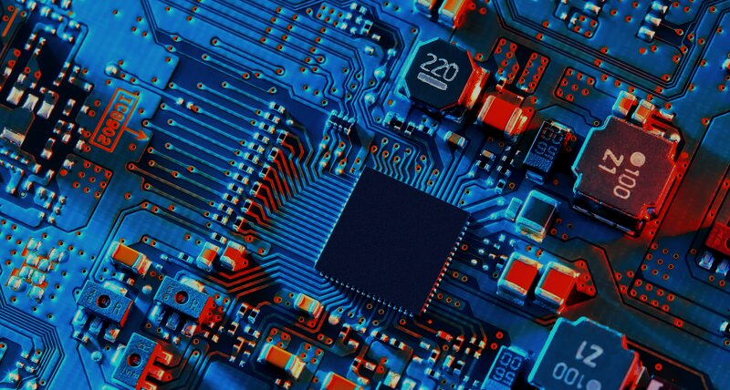
H/W,S/W
Requirements
H/W :
PC
Arduino Uno.
5v 4 channel Relay Board
AC/DC converter.
Male-Female sockets and jumpers.
LED (1.5v and 220v).
Ethernet cable.
12v power supply.
S/W:
Python 3.8 and higher
Any python IDE(Visual Studio Code)
Arduino Dev IDE
Microsoft Sapi5
Preferred installer Program (PIP) latest version

Slide 10
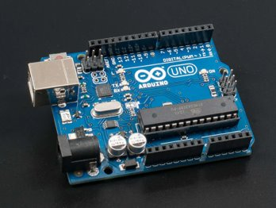
Arduino uno
Arduino is an open source electronic platform based on easy to use hardware and software. Arduino boards are able to read input such as light on sensor, finger on button and turn it into an output like activating a motor, turning on an LED etc.
Arduino is the single board microcontroller and the software used for Arduino is Arduino IDE.

Slide 11
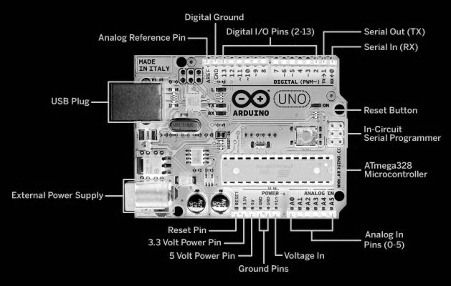
Arduino uno Schematics

Slide 12
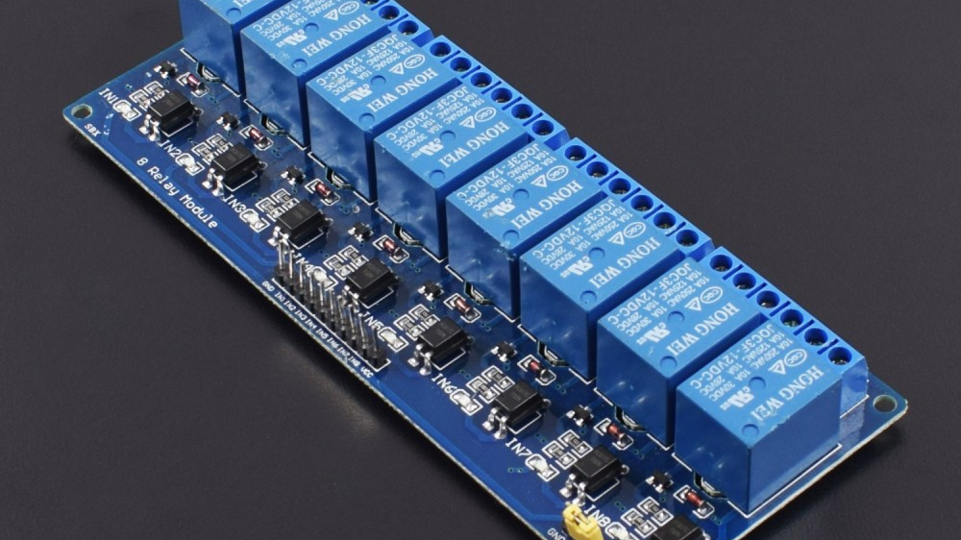
Relay board
Relay boards are computer boards with an array of relays and switches. They have input and output terminals and are designed to control the voltage supply. Relay boards provide independently programmable, real-time control for each of several onboard relay channels.
Relay boards with opto-isolators provide isolation between control signals and output controls. Most relay boards have 2, 4, 8 or 10 channels.

Slide 13

Role of Python
Python offers many features that are helpful for AI (Artificial Intelligence ) and ML (Machine Learning) in particular, and that makes it the best language for these purposes.
No wonder that various industries use Python for prediction automatic and other machine learning task

Slide 14

Use of Python In Project
Python is the core of this project as it is main coding language of the project.Also libraries like wikipedia,date time,speech recognition,email,os,web-browser,firmata,etc helps a lot by reducing the coding efforts.
AI cannot perform something unless we said to it.In other words we need to create the output for every possible input like fetching info,household light switching,sending mails,etc.
To control the arduino using python is a tough thing to do but by this we can nearly control every electronic device which come under (220v 10A) ratings.

Slide 15
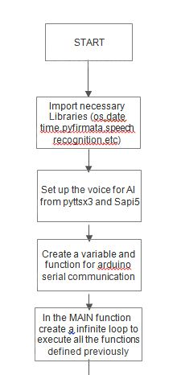
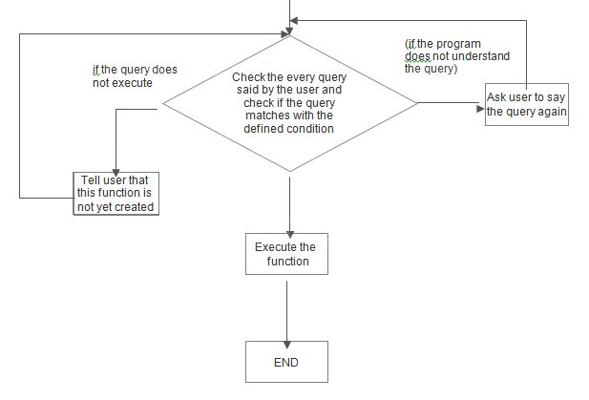
BLOCK DIAGRAM

Slide 16
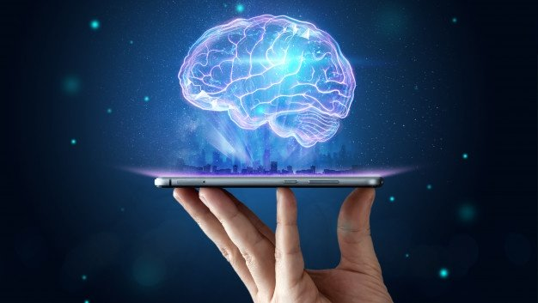
Advantage
AI is making it easier for people to do things every day, whether it's searching for photos of loved ones, breaking down language barriers in Google Translate, typing emails and more.
AI is powering many inventions in almost every domain which will help humans solve the majority of complex problems.
Using artificial intelligence we can productively automate these mundane tasks and can even remove “boring” tasks for humans
using AI we can make machines work 24x7 without any breaks

Slide 17
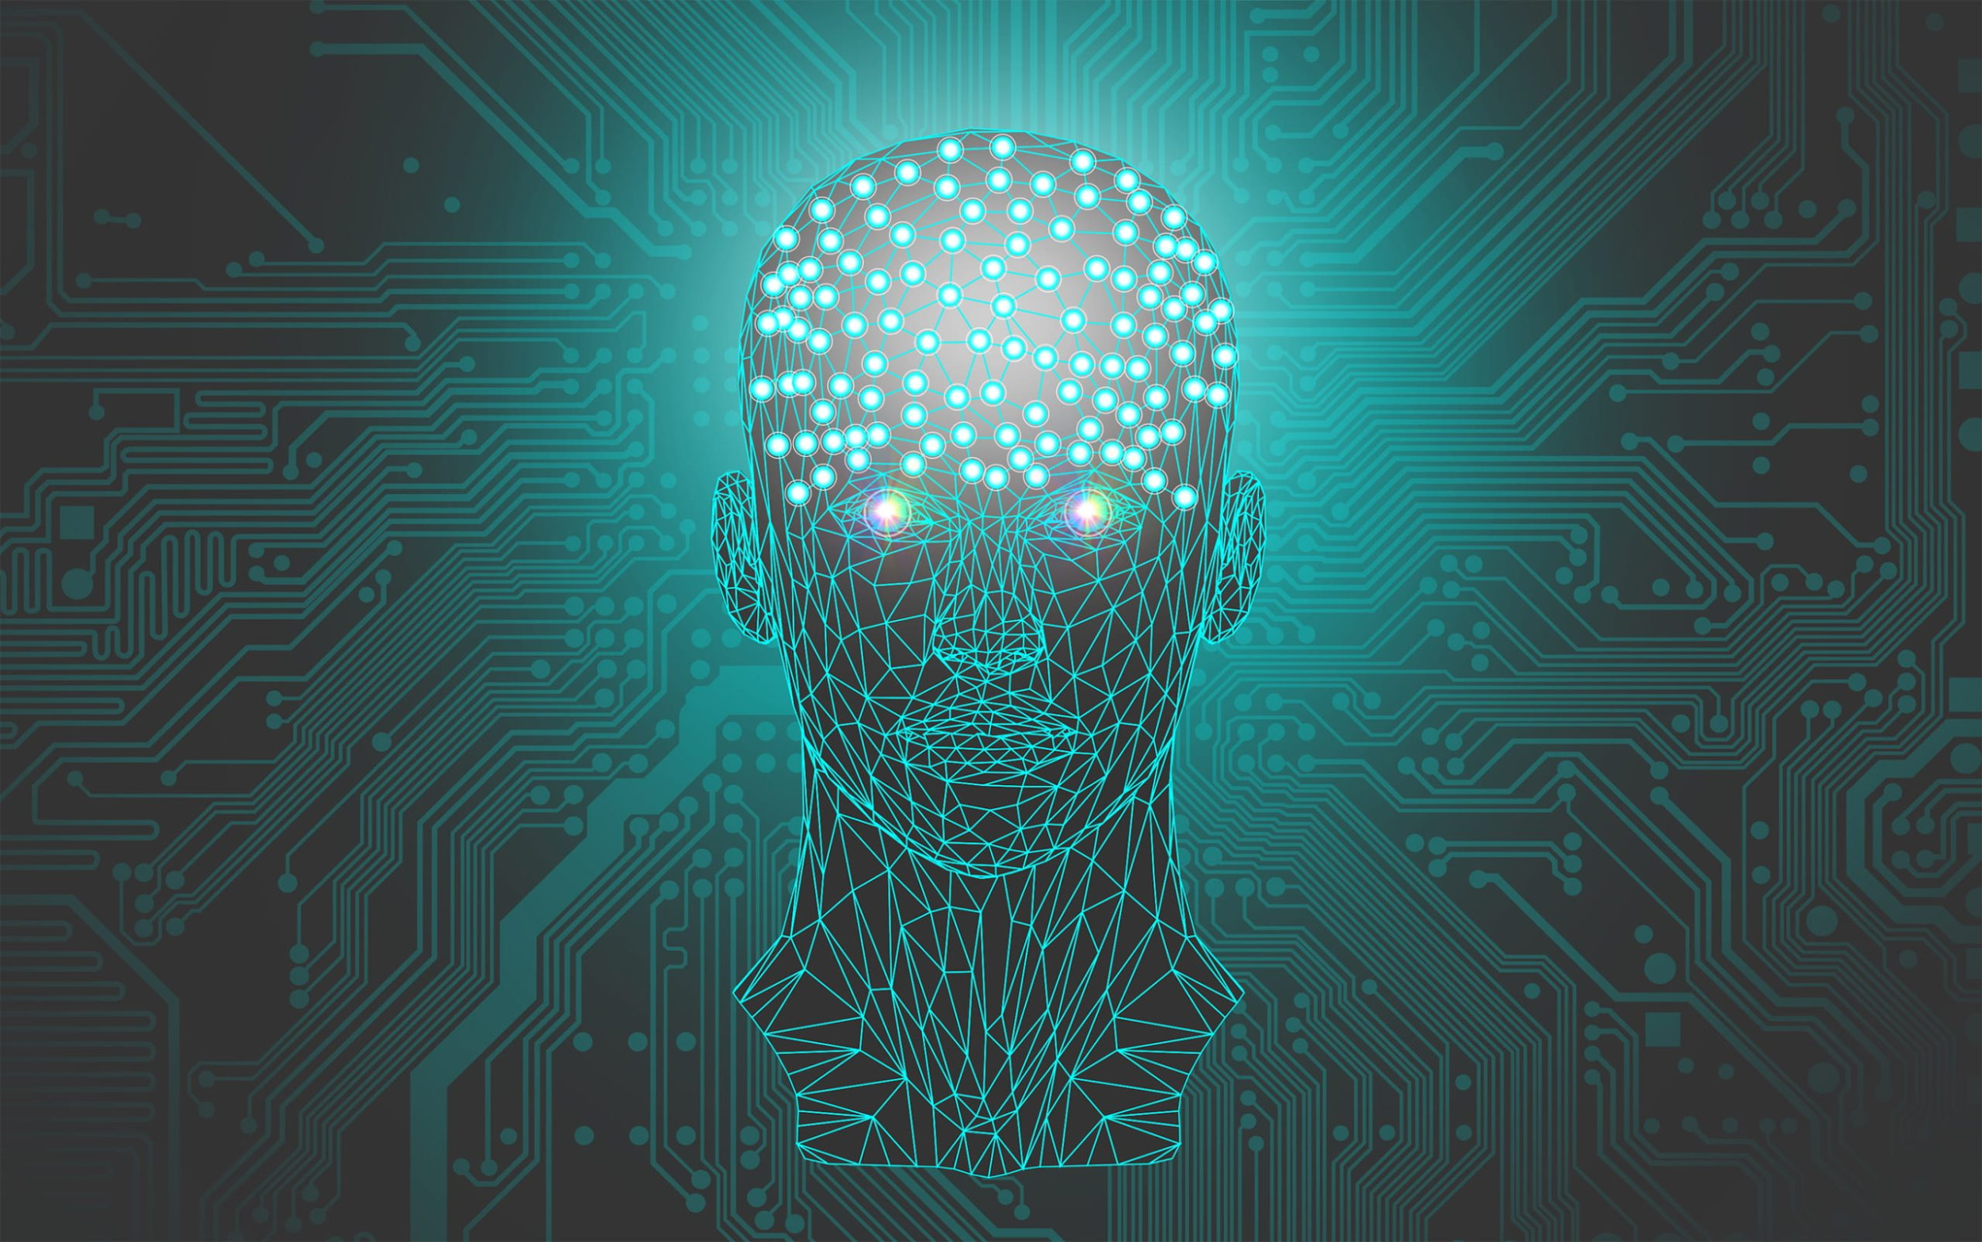
Disadvantage
It’ s creation requires a high end compiler provided with system with same specifications as the code contains many different complex task.
AI with its applications automating the majority of the work but still there are some tasks that only human brain can perform.
As AI is replacing the majority of works with robots, human interference is becoming less which will cause a major problem in the employment standards.

Slide 18
Applications
Quick Searches
Voice controlled Email transmission and reception.
Voice controlled automation of desktop.
Controlling electronic devices such as lights,ceiling fan,etc.
Artificial intelligence can be applicable in educational,medical, industrial fields and many more
It can be very helpful for people with disabilities
Chatbot

Slide 19

Al is at the center of a new enterprise to build computational models of intelligence. This small prototype with some advance modifications and proper guidelines can be turned out to very successful product because in the field of artificial intelligence 'sky is the only limit'

Slide 20
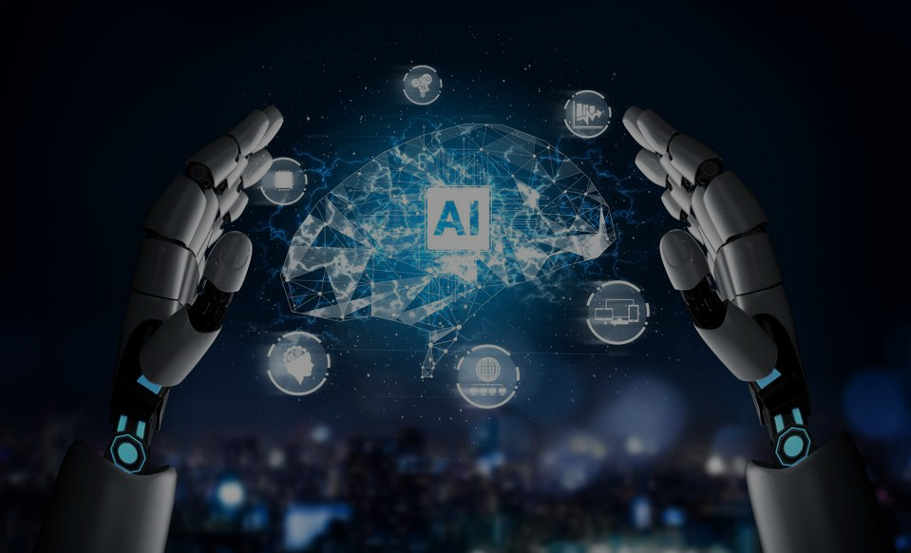
REFERENCES
https://towardsdatascience.com/
https://www.globalspec.com/
https://www.linkedin.com/
https://emerituscollege.asu.edu/
https://www.youtube.com/
https://stackoverflow.com/

